Slide 1
VE320 – Summer 2021
Semiconductor Physics
Instructor: Yaping Dan （但亚平）
yaping.dan@sjtu.edu.cn
Chapter 10 Fundamentals of Metal-Oxide-Semiconductor Field Effect Transistors

Slide 2
Outline
10.1 The two-terminal MOS structure
10.2 Capacitance-voltage characteristics
10.3 Non-ideal effects
10.4 The basic MOSFET operation

Slide 3
Outline
10.1 The two-terminal MOS structure
10.2 Capacitance-voltage characteristics
10.3 Non-ideal effects
10.4 The basic MOSFET operation

Slide 4
10.1 The two-terminal MOS structure
V_{g}
Metal
SiO₂
Metal oxide semiconductor
Metal-insulator-semiconductor (MIS)
V_{g} = 0
E_{F}
eφ_{fp}
p- Si
Flat band

Slide 5
10.1 The two-terminal MOS structure
Metal oxide semiconductor
V_{g} < 0
E_{F}
V_{g}
Metal
eφ_{fp}
Accumulation
SiO₂
Metal-insulator-semiconductor (MIS)
V_{g} = 0
E_{F}
eφ_{fp}
p- Si
Flat band

Slide 6
10.1 The two-terminal MOS structure
Metal oxide semiconductor
V_{g} < 0
E_{F}
V_{g}
Metal
eφ_{fp}
Accumulation
SiO₂
Metal-insulator-semiconductor (MIS)
V_{g} = 0
E_{F}
eφ_{fp}
p- Si
Flat band
eφ_{fp}
V_{g} > 0
E_{F}
Depletion

Slide 7
10.1 The two-terminal MOS structure
Metal oxide semiconductor
V_{g} < 0
E_{F}
eφ_{fp}
Accumulation
V_{g} = 0
E_{F}
eφ_{fp}
Flat band
n_{s} = p₀
eφ_{fp}
φ_{fp}
eφ_{fp}
V_{g} = V_{T}
E_{F}
V_{g} > 0
E_{F}
Weak Inversion
Depletion

Slide 8
10.1 The two-terminal MOS structure
Metal oxide semiconductor
V_{g} < 0
E_{F}
eφ_{fp}
Accumulation
eφ_{fp}
>φ_{fp}
V_{g} > V_{T}
E_{F}
V_{g} = 0
E_{F}
eφ_{fp}
Strong Inversion
Flat band
n_{s} = p₀
eφ_{fp}
φ_{fp}
eφ_{fp}
V_{g} = V_{T}
E_{F}
V_{g} > 0
E_{F}
Weak Inversion
Depletion

Slide 9
10.1 The two-terminal MOS structure
Charge distribution
Metal oxide semiconductor
E_{F}
V_{g} < 0
-eV_{g}
-eφ_{fp}
eφ_{fp}
Accumulation
+ Q
- Q

Slide 10
10.1 The two-terminal MOS structure
Charge distribution
Fixed charge
+ Q
+ Q
electrons
- Q
- Q
φ_{s} = 2φ_{b}
eφ_{fp}
eφ_{fp}
eφ_{fp}
V_{g} = V_{T}
E_{F}
V_{g} > 0
E_{F}
Weak inversion
Depletion

Slide 11

10.1 The two-terminal MOS structure
Charge distribution
W
eφ_{fp}
eφ_{s}
E_{F}
x_{d}
$$∅_{s}>2∅_{fp}$$
Fixed charge
+ Q
electrons
- Q

Slide 12
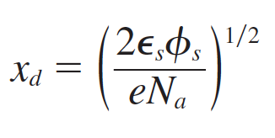
10.1 The two-terminal MOS structure
Depletion layer thickness
+ Q
- Q
eφ_{fp}
V_{g} > 0
E_{F}
Depletion

Slide 13
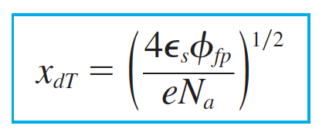

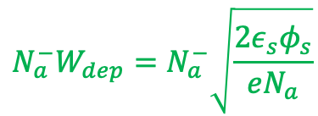
10.1 The two-terminal MOS structure
Depletion layer thickness
W
Maximum depletion layer
eφ_{b}
eφ_{s}
Charges
per unit area
E_{F}
$$n_{s}δ$$
x_{d}
$$∅_{s}>2∅_{fp}$$
$$N_{a}^{−}W_{dep}=N_{a}^{−}\sqrt{\frac{2ε_{s}φ_{s}}{eN_{a}}}$$
Fixed charge
+ Q
electrons
- Q

Slide 14
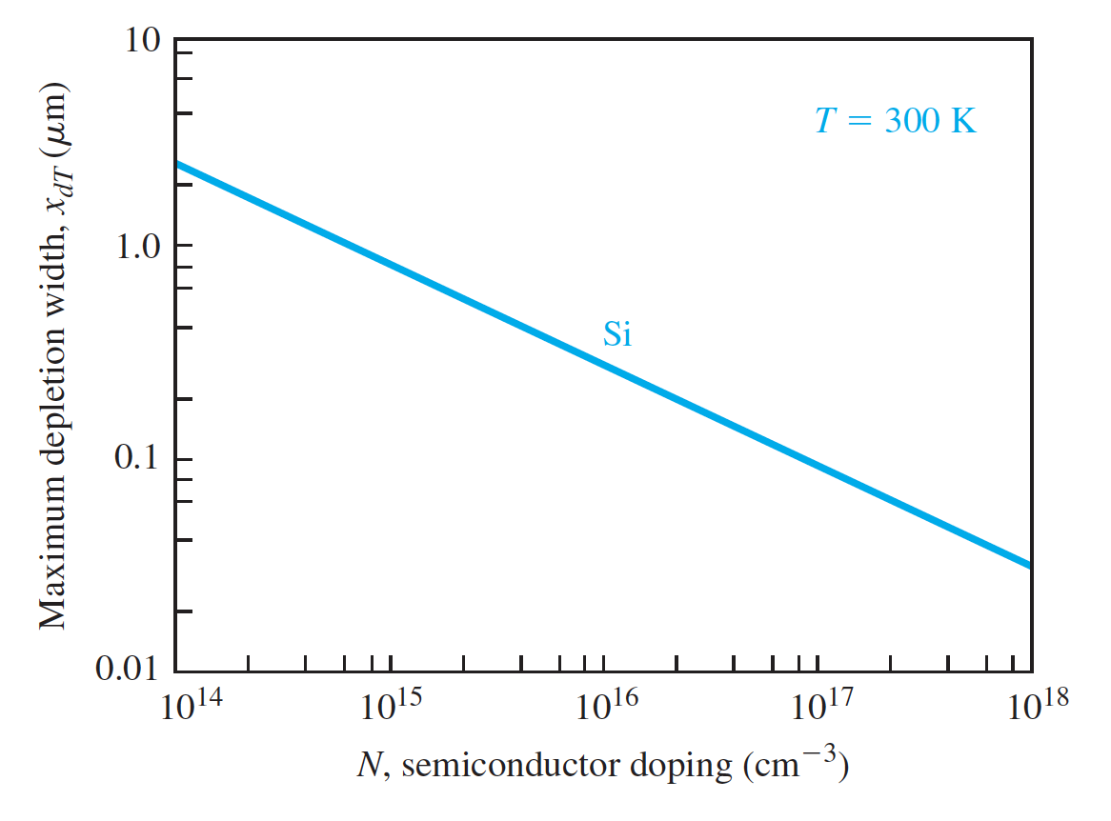
10.1 The two-terminal MOS structure
Depletion layer thickness
Maximum depletion layer

Slide 15
Outline
10.1 The two-terminal MOS structure
10.2 Capacitance-voltage characteristics
10.3 Non-ideal effects
10.4 The basic MOSFET operation

Slide 16


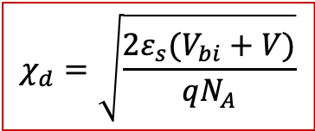

10.2 The capacitance-voltage characteristics
metal
depletion
oxide
+++
+++
- - -
- - -
n-type
p-type
$$C_{m}=\frac{ε_{ox}}{W_{ox}}$$
$χ$_{d}
$$C_{s}=\frac{ε_{s}}{χ_{d}}$$
W_{ox}
$$χ_{d}=\sqrt{\frac{2ε_{s}(V_{bi}+V)}{qN_{A}}}$$

Slide 17


10.2 The capacitance-voltage characteristics
metal
depletion
oxide
+++
+++
- - -
- - -
n-type
p-type
$$C_{m}=\frac{ε_{ox}}{W_{ox}}$$
$χ$_{d}
$$C_{s}=\frac{ε_{s}}{χ_{d}}$$
W_{ox}
depletion
$$χ_{d}=\sqrt{\frac{2ε_{s}(V_{bi}+V)}{qN_{A}}}$$
- - -
- - -
- - -
V_{g}
oxide
p-type
V_{g}
W_{ox}
$χ$_{d}
C_{ox}
C_{s}

Slide 18



10.2 The capacitance-voltage characteristics
V_{s}
V_{s}
n_{s} = p₀
V_{g} > 0
E_{F}
V_{g} = V_{T}
E_{F}
Weak Inversion
Depletion
$$C_{s}=\frac{ε_{s}}{χ_{d}}$$
Net charge is zero!
depletion
$$χ_{d}=\sqrt{\frac{2ε_{s}(V_{bi}+V)}{qN_{A}}}$$
$${(V}_{g}−V_{s})C_{ox}=V_{s}C_{s}$$
- - -
- - -
- - -
$$V_{g}C_{ox}={V_{s}C_{ox}+V}_{s}C_{s}$$
V_{g}
oxide
p-type
V_{s}
V_{g}
$$V_{s}=\frac{V_{g}C_{ox}}{{C_{ox}+C}_{s}}$$
$χ$_{d}
W_{ox}
C_{ox}
C_{s}

Slide 19
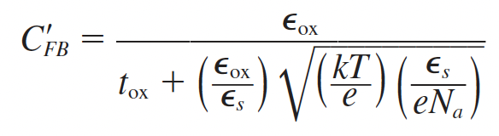
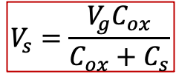

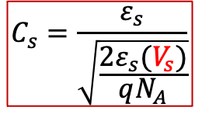
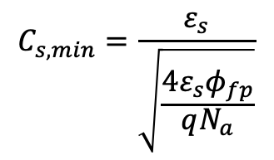
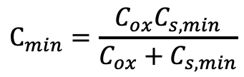

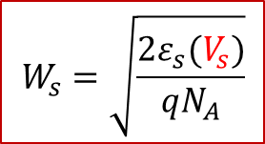


10.2 The capacitance-voltage characteristics
$$C=\frac{C_{ox}C_{s}}{C_{ox}+C_{s}}$$
$$V_{s}=\frac{V_{g}C_{ox}}{{C_{ox}+C}_{s}}$$
$$C_{fb}$$
$$C_{min}=\frac{C_{ox}C_{s,min}}{C_{ox}+C_{s,min}}$$
$$C_{s}=\frac{ε_{s}}{\sqrt{\frac{2ε_{s}(V_{s})}{qN_{A}}}}$$
$$C_{s,min}=\frac{ε_{s}}{\sqrt{\frac{4ε_{s}φ_{fp}}{qN_{a}}}}$$
$$C_{s,min}$$
0 V_{T}
$$V_{g}$$
Net charge is zero!
depletion
$$W_{s}=\sqrt{\frac{2ε_{s}(V_{s})}{qN_{A}}}$$
$${(V}_{g}−V_{s})C_{ox}=V_{s}C_{s}$$
- - -
- - -
- - -
$$V_{g}C_{ox}={V_{s}C_{ox}+V}_{s}C_{s}$$
V_{g}
oxide
p-type
V_{s}
V_{g}
$$V_{s}=\frac{V_{g}C_{ox}}{{C_{ox}+C}_{s}}$$
W_{s}
W_{ox}
C_{ox}
C_{s}

Slide 20



10.2 The capacitance-voltage characteristics
Accumulation
$$C=\frac{C_{ox}C_{s}}{C_{ox}+C_{s}}$$
Metal oxide semiconductor
$$C_{ox}$$
E_{F}
V_{g} < 0
-eV_{g}
-eφ_{s}
eφ_{fp}
0 V_{T}
$$V_{g}$$
Accumulation
+ Q
$$C_{s}→ ∞$$
$$C=\frac{C_{s}C_{ox}}{C_{s}+C_{ox}}≈C_{ox}$$
- Q

Slide 21
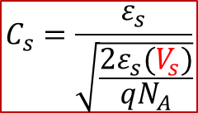
10.2 The capacitance-voltage characteristics
Depletion and weak inversion
$$C=\frac{C_{ox}C_{s}}{C_{ox}+C_{s}}$$
$$C_{ox}$$
$$C_{s}=\frac{ε_{s}}{\sqrt{\frac{2ε_{s}(V_{s})}{qN_{A}}}}$$
0 V_{T}
$$V_{g}$$
Fixed charge
+ Q
+ Q
electrons
- Q
- Q
φ_{s} = 2φ_{fp}
eφ_{fp}
eφ_{fp}
eφ_{fp}
V_{g} = V_{T}
E_{F}
V_{g} > 0
E_{F}
Weak inversion
Depletion

Slide 22


10.2 The capacitance-voltage characteristics
Strong inversion
$$C=\frac{C_{ox}C_{s}}{C_{ox}+C_{s}}$$
W
$$C_{ox}$$
eφ_{fp}
eφ_{s}
0 V_{T}
$$V_{g}$$
E_{F}
x_{d}
$$∅_{s}>2∅_{fp}$$
$$C_{s}→ ∞$$
$$C=\frac{C_{s}C_{ox}}{C_{s}+C_{ox}}≈C_{ox}$$
Fixed charge
+ Q
electrons
- Q

Slide 23
10.2 The capacitance-voltage characteristics
Strong inversion
$$C=\frac{C_{ox}C_{s}}{C_{ox}+C_{s}}$$
W
$$C_{ox}$$
eφ_{fp}
eφ_{s}
0 V_{T}
$$V_{g}$$
E_{F}
x_{d}
$$∅_{s}>2∅_{fp}$$
$$C_{s}→ ∞$$
$$C=\frac{C_{s}C_{ox}}{C_{s}+C_{ox}}≈C_{ox}$$
Fixed charge
+ Q
electrons
- Q

Slide 24
10.2 The capacitance-voltage characteristics
n-type semiconductor
1.0
C/C₀
Low f
Flat band
E_{F}
eφ_{fp}
High f
V_{g} = 0
Flat band
0
V_{g}
n-type substrate
V_{g}= V_{T}

Slide 25
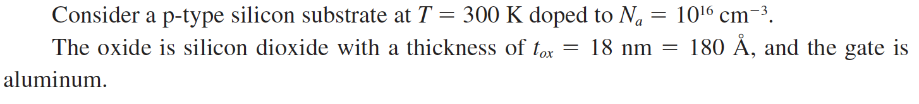
10.2 The capacitance-voltage characteristics
Problem Example

Slide 26
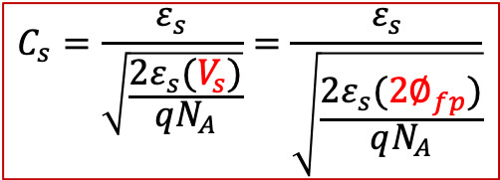
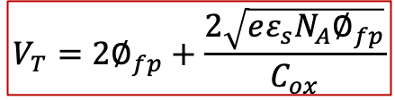
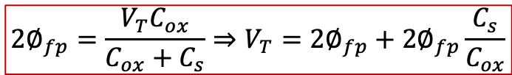
10.2 The capacitance-voltage characteristics
Threshold voltage
$$C_{s}=\frac{ε_{s}}{\sqrt{\frac{2ε_{s}(V_{s})}{qN_{A}}}}=\frac{ε_{s}}{\sqrt{\frac{2ε_{s}({2∅}_{fp})}{qN_{A}}}}$$
$$2∅_{fp}=\frac{V_{T}C_{ox}}{{C_{ox}+C}_{s}}⇒V_{T}=2∅_{fp}+2∅_{fp}\frac{C_{s}}{C_{ox}}$$
Fixed charge
+ Q
electrons
- Q
$$V_{T}=2∅_{fp}+\frac{2\sqrt{eε_{s}N_{A}∅_{fp}}}{C_{ox}}$$
V_{s} = 2φ_{fp}
eφ_{fp}
eφ_{fp}
V_{g} = V_{T}
E_{F}
Weak inversion

Slide 27
10.2 The capacitance-voltage characteristics: summary
Metal oxide semiconductor
V_{g} < 0
E_{F}
eφ_{b}
V_{g} > V_{T}
E_{F}
>φ_{b}
eφ_{fp}
Strong Inversion
Accumulation
+Q
1.0
-Q
holes
C/C₀
Flat band
V_{g} = 0
E_{F}
eφ_{fp}
Flat band
0
V_{g}
V_{g}= V_{T}
eφ_{fp}
φ_{fp}
eφ_{fp}
V_{g} > 0
E_{F}
V_{g} = V_{T}
E_{F}
Depletion
Weak inversion

Slide 28

Question:
Appear and disappear
Where are the electrons coming from and going to?
eφ_{fp}
eφ_{s}
E_{F}
x_{d}
$$∅_{s}>2∅_{fp}$$

Slide 29
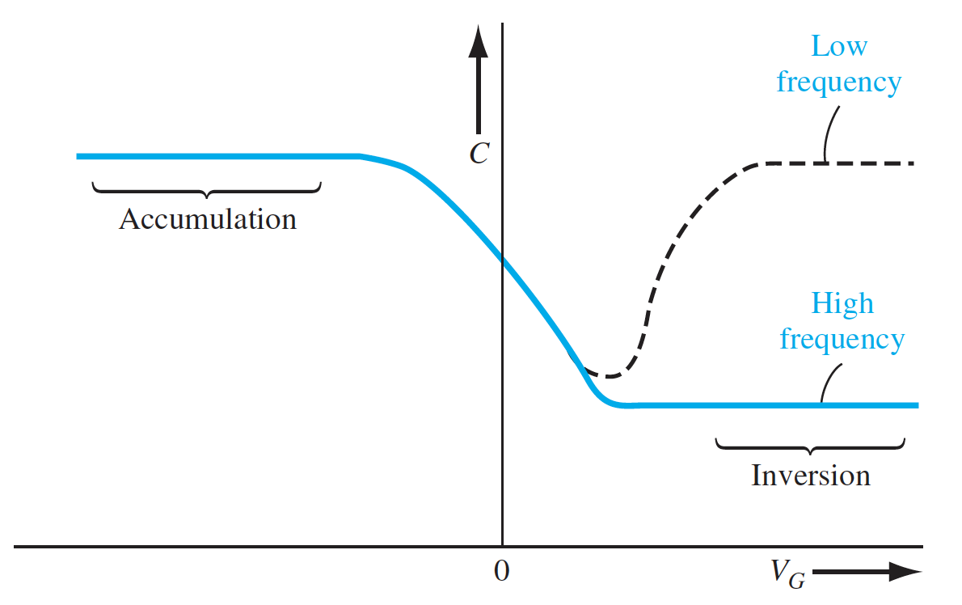
10.2 The capacitance-voltage characteristics
Frequency dependence

Slide 30
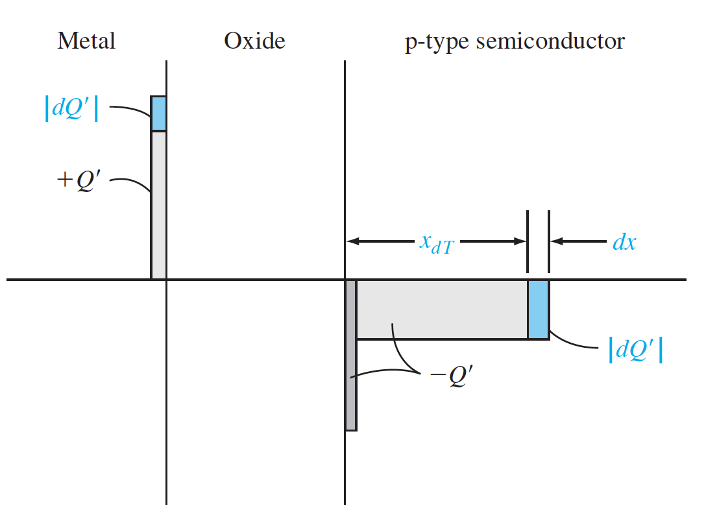
10.2 The capacitance-voltage characteristics
Frequency dependence

Slide 31
Outline
10.1 The two-terminal MOS structure
10.2 Capacitance-voltage characteristics
10.3 Non-ideal effects
10.4 The basic MOSFET operation

Slide 32

10.3 Non-ideal effects
Work function difference
V_{g}
Metal
Metal oxide semiconductor
Vacuum level
SiO₂
W_{s}
Metal-insulator-semiconductor (MIS)
W_{m}
V_{g} = 0
eφ_{fp}
p- Si
E_{F}
Flat band
$$V_{FB}=0$$

Slide 33
10.3 Non-ideal effects
Work function difference
V_{g}
Metal
Metal oxide semiconductor
-
-
Vacuum level
-
-
SiO₂
-
W_{s}
-
-
W_{m}
-
Metal-insulator-semiconductor (MIS)
-
V_{g} = 0
-
E_{F}
eφ_{fp}
-
p- Si
-
-
-
-
-
-
-

Slide 34
10.3 Non-ideal effects
Work function difference
V_{g}
Metal
Metal oxide semiconductor
-
-
Vacuum level
-
-
SiO₂
-
W_{s}
-
-
W_{m}
-
Metal-insulator-semiconductor (MIS)
-
V_{g} = 0
-
E_{F}
eφ_{fp}
-
p- Si
-
-
-
-
-
-
-
ΔV_{g} = 0 V
+ -

Slide 35

10.3 Non-ideal effects
Work function difference
V_{g}
Metal
Metal oxide semiconductor
Vacuum level
SiO₂
W_{s}
Metal-insulator-semiconductor (MIS)
W_{m}
eφ_{fp}
p- Si
E_{F}
Flat band
$$V_{FB}=(W_{m}−W_{s})/q$$
ΔV_{g} = (W_{m}-W_{s})/q = Φ_{ms}
+ -

Slide 36
10.3 Non-ideal effects
Work function difference
1.0
C/C₀
Flat band
Low f
Metal oxide semiconductor
High f
Vacuum level
0
V_{g}
W_{s}
V_{g}= V_{T}
W_{m}
ΔV_{g} = (W_{m}-W_{s})/q
V_{g} = 0
eφ_{fp}
E_{F}
1.0
$$V_{FB}=(W_{m}−W_{s})/q$$
Flat band
C/C₀
Flat band
Low f
High f
ΔV_{g} = (W_{m}-W_{s})/q = Φ_{ms}
+ -
V_{g}= V_{T}
0
V_{g}

Slide 37
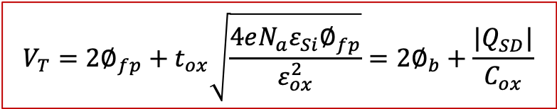
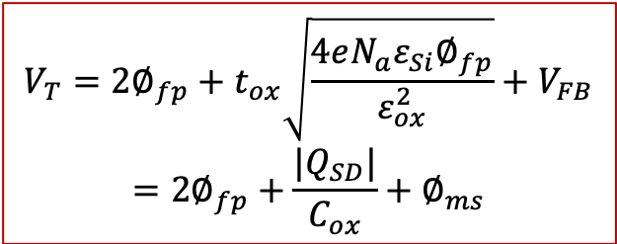
10.3 Non-ideal effects
Work function difference
1.0
$$V_{T}={2∅}_{fp}+t_{ox}\sqrt{\frac{4eN_{a}ε_{Si}∅_{fp}}{ε_{ox}^{2}}}={2∅}_{b}+\frac{|Q_{SD}|}{C_{ox}}$$
C/C₀
Flat band
Low f
High f
0
V_{g}
V_{g}= V_{T}
ΔV_{g} = (W_{m}-W_{s})/q
1.0
$$V_{T}={2∅}_{fp}+t_{ox}\sqrt{\frac{4eN_{a}ε_{Si}∅_{fp}}{ε_{ox}^{2}}}+V_{FB}$$
$$={2∅}_{fp}+\frac{|Q_{SD}|}{C_{ox}}+∅_{ms}$$
C/C₀
Flat band
Low f
High f
V_{g}= V_{T}
0
V_{g}

Slide 38

10.3 Non-ideal effects
Fixed charges
Metal oxide semiconductor
Fixed charges Q_{ss}
interface
+
V_{g}
Metal
+
+
+
eφ_{fp}
+
E_{F}
+
+
SiO₂
+
+
+
Depletion
+
Metal-insulator-semiconductor (MIS)
+
+
p- Si
+
-
+
+
-
+
+
E_{F}
-
+
+
-
+
eφ_{fp}
+
-
+
Flat band
$$V_{g}=V_{FB}=−Q_{ss}/C$$

Slide 39

10.3 Non-ideal effects
Fixed charges
Metal oxide semiconductor
Fixed charges Q_{ss}
middle
+
V_{g}
Metal
+
+
+
eφ_{fp}
+
E_{F}
+
+
SiO₂
+
+
Depletion
+
+
Metal-insulator-semiconductor (MIS)
+
+
p- Si
+
-
+
+
-
+
+
E_{F}
-
+
eφ_{fp}
+
-
+
+
-
+
Flat band
$$V_{g}=V_{FB}=−Q_{ss}/2C$$

Slide 40
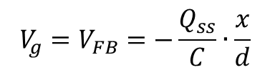
10.3 Non-ideal effects
Fixed charges
Metal oxide semiconductor
Fixed charges Q_{ss}
x from metal
+
V_{g}
Metal
+
+
+
Eφ_{fp}
+
E_{F}
+
+
SiO₂
+
+
+
Depletion
+
Metal-insulator-semiconductor (MIS)
+
+
p- Si
+
-
+
+
-
+
+
E_{F}
-
+
eφ_{fp}
+
-
+
+
-
+
Flat band
$$V_{g}=V_{FB}=−\frac{Q_{ss}}{C}∙\frac{x}{d}$$

Slide 41
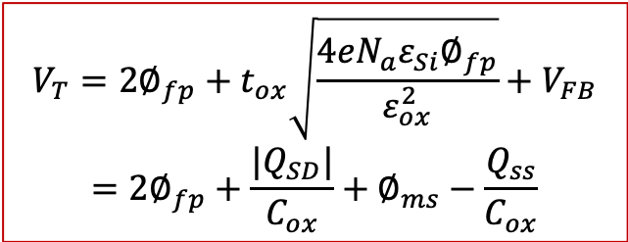
10.3 Non-ideal effects
Fixed charges
V_{FB}
1.0
1.0
C/C₀
Flat band
Low f
C/C₀
Flat band
Low f
High f
High f
0
V_{g}
0
V_{g}
V_{g}= V_{T}
V_{g}= V_{T} + V_{FB}
ΔV_{g} = (W_{m}-W_{s})/q
1.0
$$V_{T}={2∅}_{fp}+t_{ox}\sqrt{\frac{4eN_{a}ε_{Si}∅_{fp}}{ε_{ox}^{2}}}+V_{FB}$$
$$={2∅}_{fp}+\frac{|Q_{SD}|}{C_{ox}}+∅_{ms}−\frac{Q_{ss}}{C_{ox}}$$
C/C₀
Flat band
Low f
High f
V_{g}= V_{T}
0
V_{g}

Slide 42
Outline
10.1 The two-terminal MOS structure
10.2 Capacitance-voltage characteristics
10.3 Non-ideal effects
10.4 The basic MOSFET operation

Slide 43
10.4 The basic MOSFET operation
Metal-Oxide-Semiconductor field effect transistor: MOSFET
V_{g}
V_{g}
Metal
Metal
SiO₂
SiO₂
n+
n+
p- Si
p- Si
MOS capacitor
MOSFET

Slide 44
10.4 The basic MOSFET operation
Metal-Oxide-Semiconductor field effect transistor: MOSFET
V_{g}
source
Metal
drain
V_{s}
V_{d}
D
n+
I_{ds}
n+
Current I
G
B
p- Si
S
Metal-oxide-semiconductor (MOS)

Slide 45
10.4 The basic MOSFET operation
Metal-Oxide-Semiconductor field effect transistor: MOSFET
V_{g}
source
Metal
drain
V_{s}
V_{d}
D
n+
I_{ds}
n+
Current I
G
B
p- Si
S
MOSFET

Slide 46
10.4 The basic MOSFET operation
Metal-Oxide-Semiconductor field effect transistor: p-type MOSFET
V_{g}
Drain
Metal
source
V_{d}
V_{s}
S
p+
I_{ds}
p+
Current I
G
B
n- Si
V_{dd}
D
P-type MOSFET

Slide 47
10.4 The basic MOSFET operation
Metal-Oxide-Semiconductor field effect transistor: P MOSFET
V_{g}
Drain
Metal
source
V_{d}
V_{s}
S
p+
I_{ds}
p+
Current I
G
B
n- Si
V_{dd}
D
P-type MOSFET

Slide 48
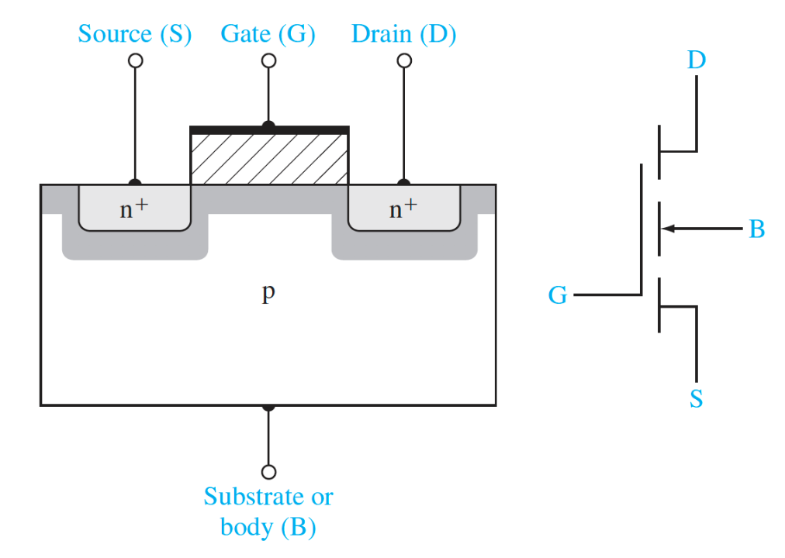
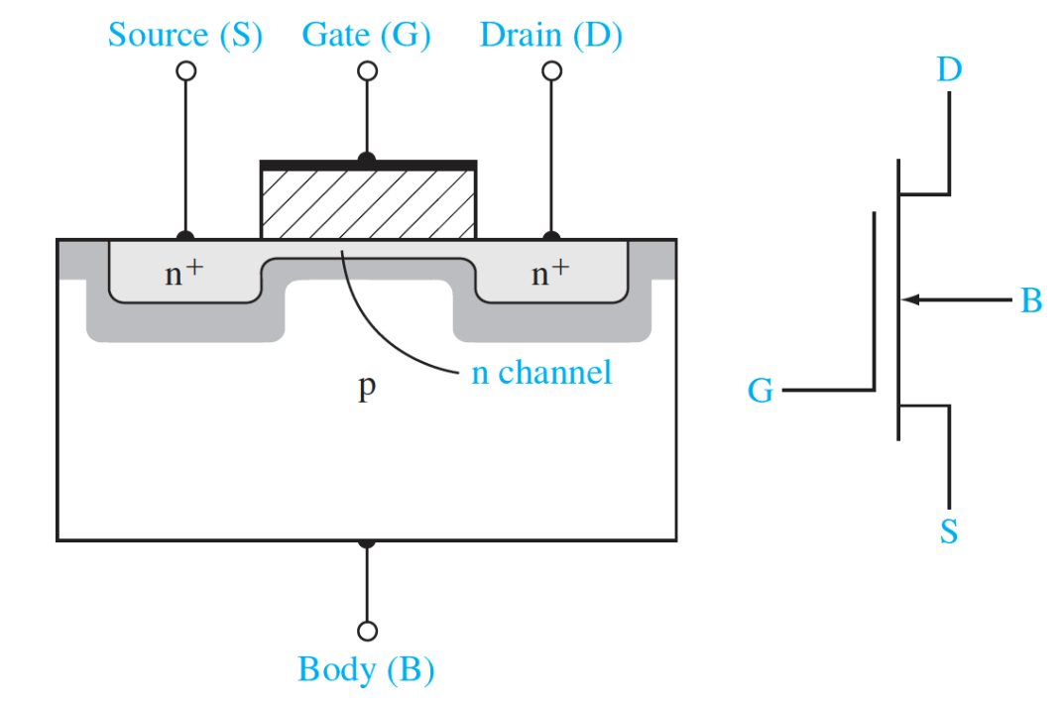
10.4 The basic MOSFET operation
MOSFET structures
NMOS Enhancement mode NMOS Depletion mode

Slide 49
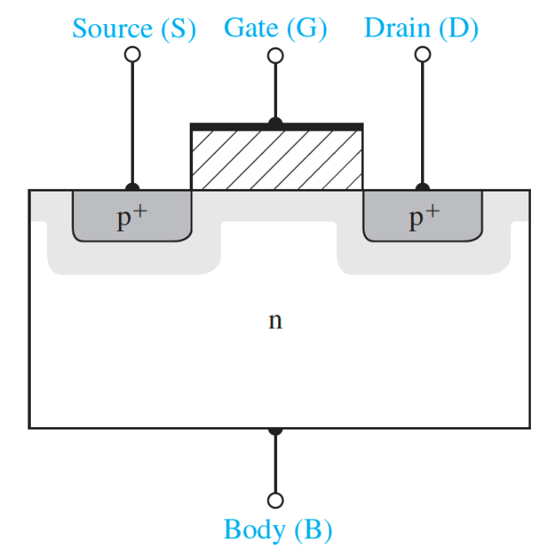
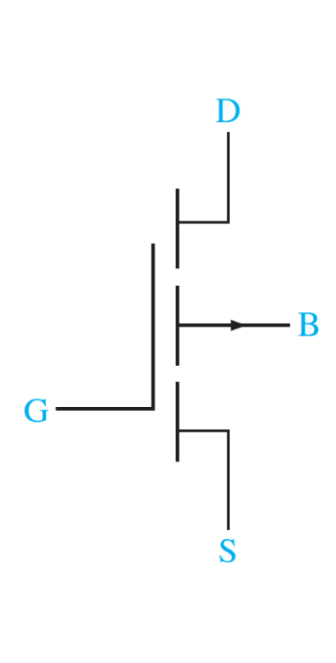
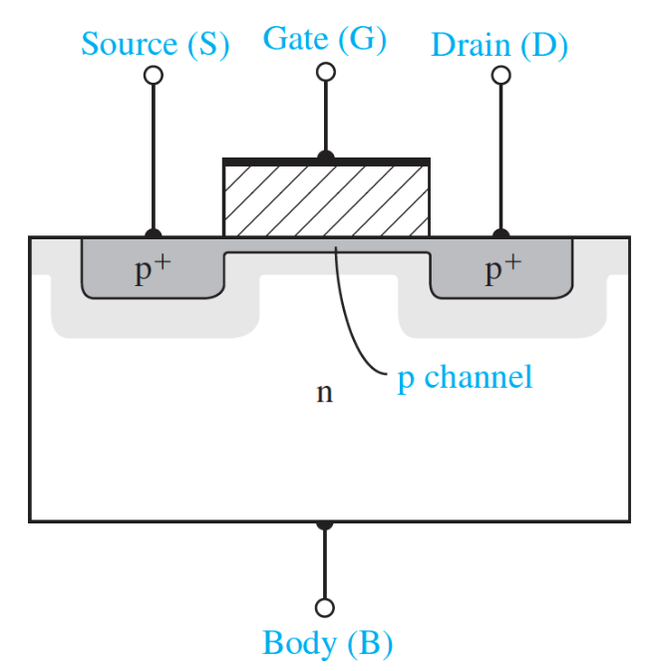

10.4 The basic MOSFET operation
MOSFET structures
PMOS Enhancement mode PMOS Depletion mode

Slide 50
10.4 The basic MOSFET operation
Metal-Oxide-Semiconductor field effect transistor: CMOS
V_{dd}
V_{g}
V_{g}
source
source
drain
Drain
V_{s}
V_{d}
V_{d}
V_{s}
n+
n+
p+
p+
n+
Current I
Current I
n- Si
p- Si
Complementary Metal-oxide-semiconductor (CMOS) field effect transistors

Slide 51
10.4 The basic MOSFET operation
f(E)
V_{d}
D
Source
Drain
V_{g}
p- Si
Metal oxide semiconductor
S
V_{g} = 0
E_{F}
eφ_{fp}
Flat band

Slide 52
10.4 The basic MOSFET operation
f(E)
V_{d}
D
Source
Drain
V_{g}
p- Si
Metal oxide semiconductor
V_{g} < 0
E_{F}
S
eφ_{fp}
Accumulation

Slide 53
10.4 The basic MOSFET operation
f(E)
V_{d}
D
Source
Drain
V_{g}
p- Si
Metal oxide semiconductor
S
eφ_{fp}
V_{g} > 0
E_{F}
Depletion

Slide 54
10.4 The basic MOSFET operation
n₀=p₀
f(E)
V_{d}
D
Source
Drain
V_{g}
p- Si
Metal oxide semiconductor
S
eφ_{fp}
φ_{fp}
V_{g} = V_{T}
E_{F}
Weak Inversion

Slide 55
10.4 The basic MOSFET operation
Δn+n₀= C_{ox}·ΔV_{g}+p₀
f(E)
V_{d}
D
Source
Drain
V_{g}
p- Si
Metal oxide semiconductor
S
eφ_{fp}
>φ_{fp}
V_{g} > V_{T}
E_{F}
Strong Inversion

Slide 56
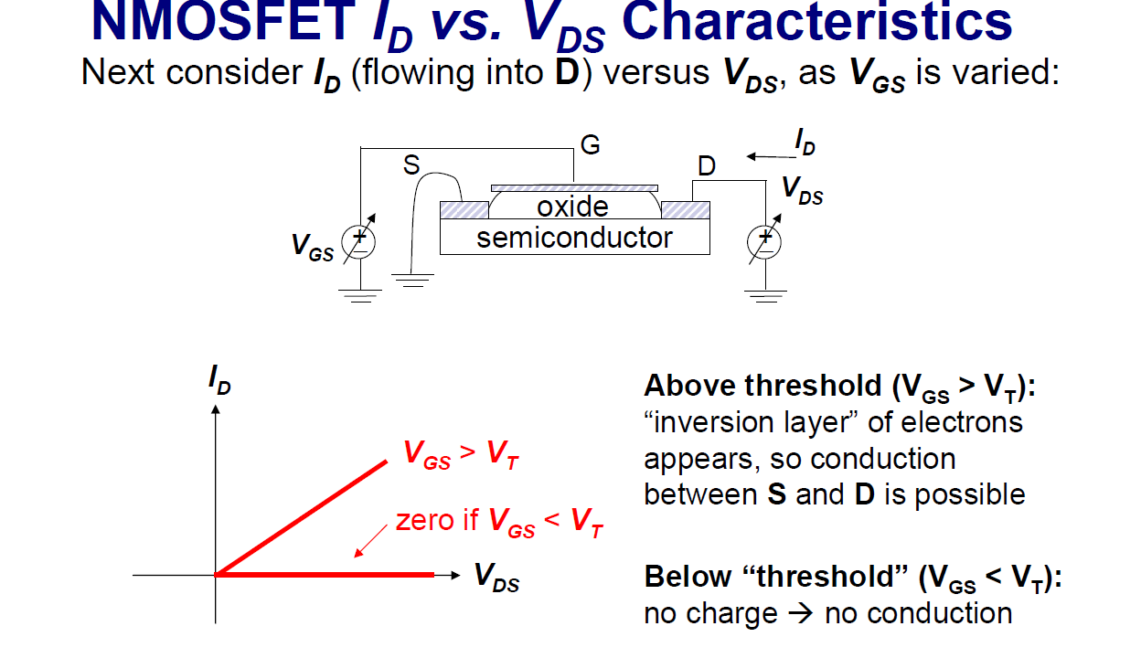
10.4 The basic MOSFET operation

Slide 57
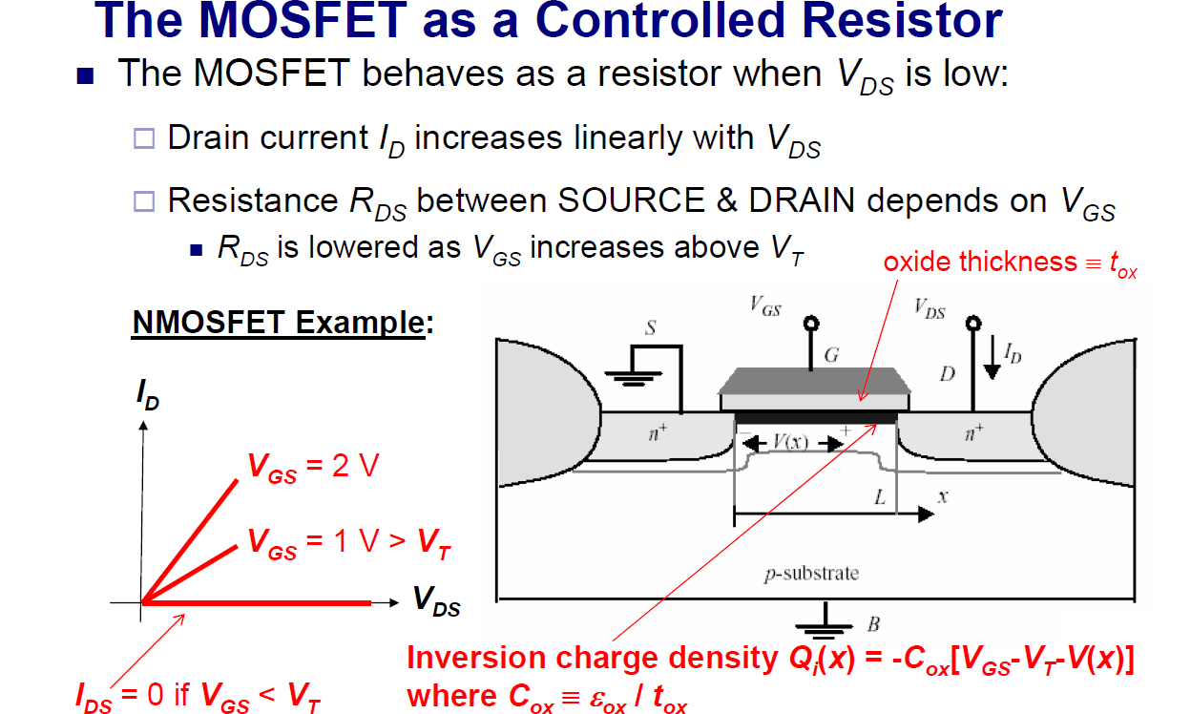
10.4 The basic MOSFET operation
Current-voltage characteristics

Slide 58

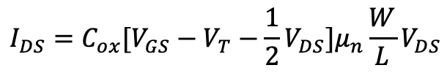
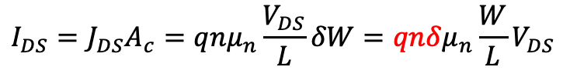
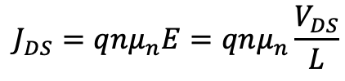
10.4 The basic MOSFET operation
$$J_{DS}=qnμ_{n}E=qnμ_{n}\frac{V_{DS}}{L}$$
$$I_{DS}=J_{DS}A_{c}=J_{DS}δW$$
$$I_{DS}=J_{DS}A_{c}=qnμ_{n}\frac{V_{DS}}{L}δW=qnδμ_{n}\frac{W}{L}V_{DS}$$
$$qnδ=−Q_{i}(x)=C_{ox}[V_{GS}−V_{T}−V(x)]$$
$$I_{DS}=C_{ox}[V_{GS}−V_{T}−\frac{1}{2}V_{DS}]μ_{n}\frac{W}{L}V_{DS}$$

Slide 59
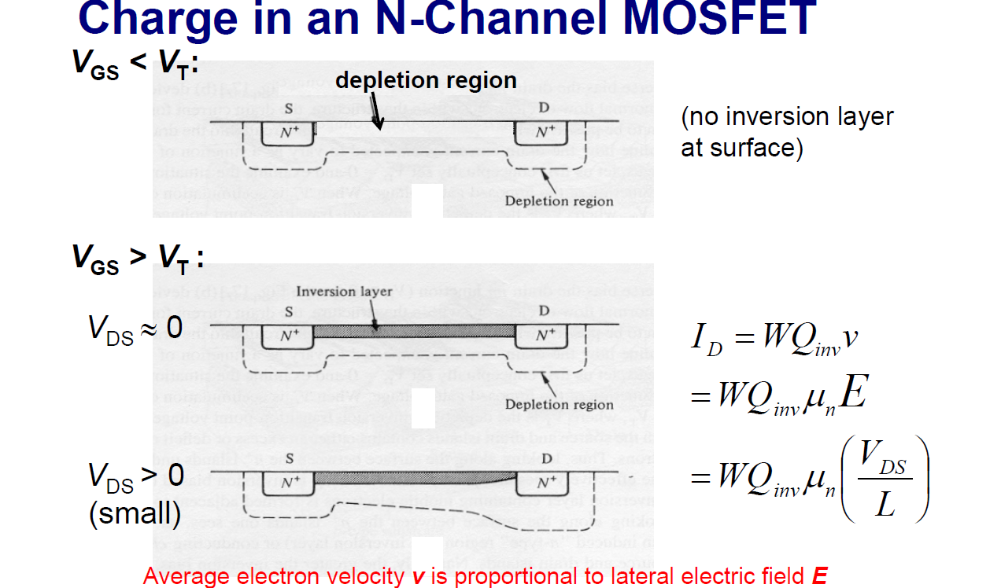
10.4 The basic MOSFET operation

Slide 60
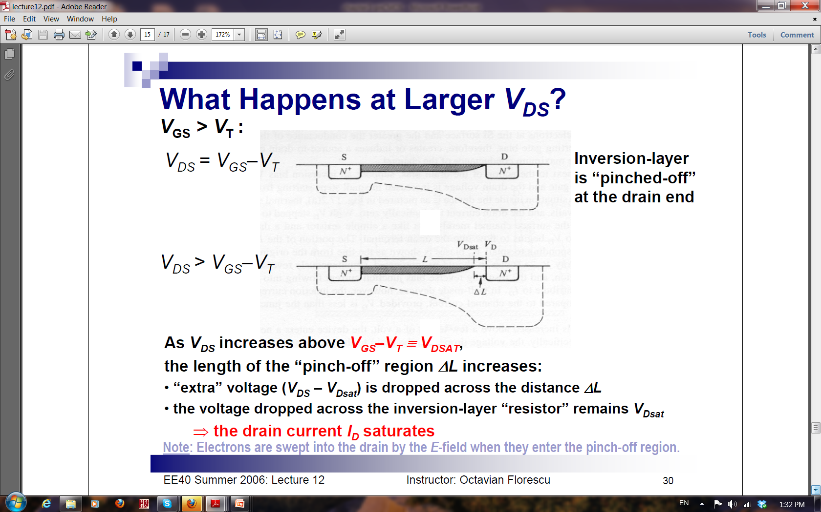
10.4 The basic MOSFET operation

Slide 61
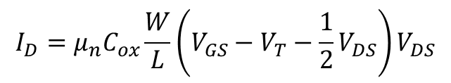
10.4 The basic MOSFET operation
$$I_{D}=μ_{n}C_{ox}\frac{W}{L}\left(V_{GS}−V_{T}−\frac{1}{2}V_{DS}\right)V_{DS}$$
I_{D} will not increase after V_{DS} ≥ V_{GS}-V_{T}
$$I_{D}=μ_{n}C_{ox}\frac{W}{L}\left(V_{GS}−V_{T}−\frac{1}{2}V_{DS}\right)V_{DS}=\frac{1}{2}μ_{n}C_{ox}\frac{W}{L}\left(V_{GS}−V_{T}\right)\left(V_{GS}−V_{T}\right)$$

Slide 62
10.4 The basic MOSFET operation
- - -
p-type
p-type
E
n-type
p-type

Slide 63
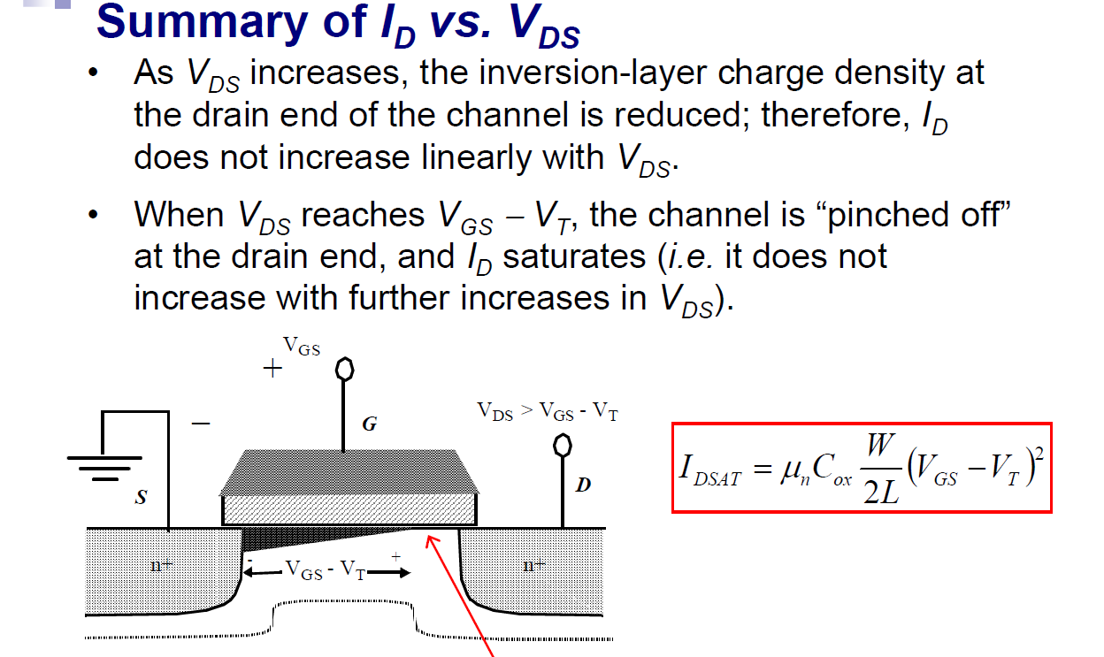
10.4 The basic MOSFET operation
Pin-off region

Slide 64
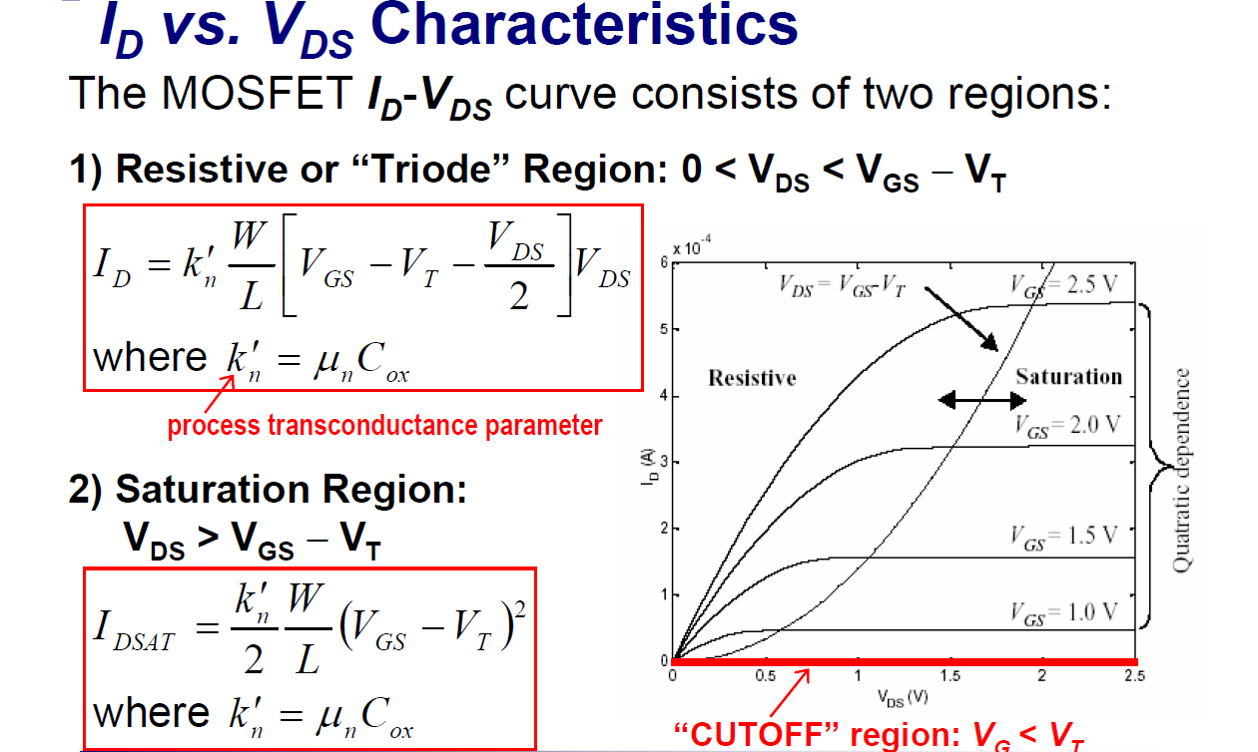
10.4 The basic MOSFET operation

Slide 65
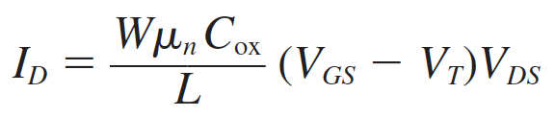
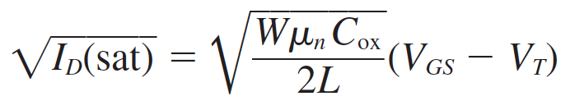
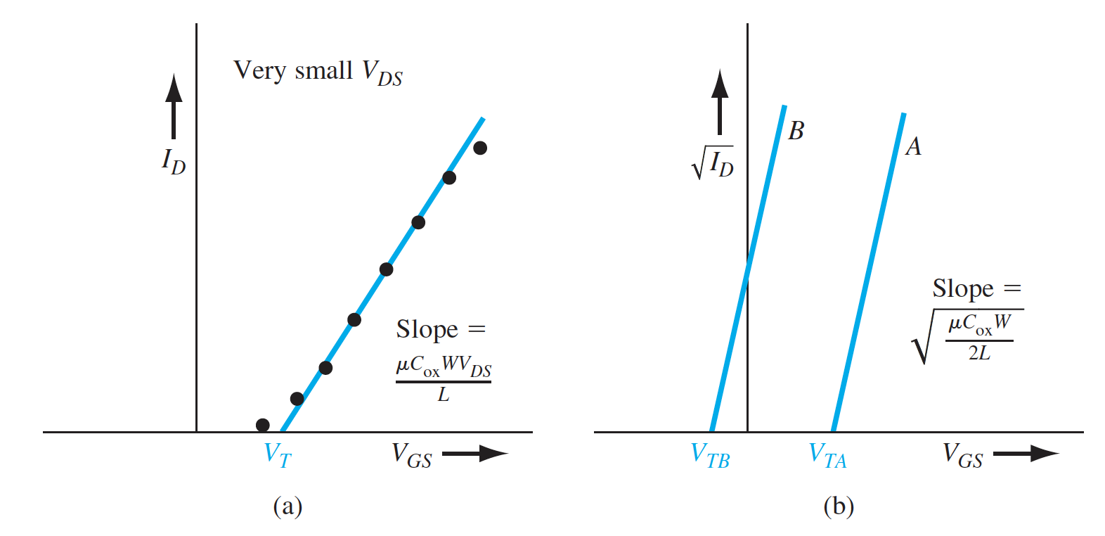
10.4 The basic MOSFET operation

Slide 66
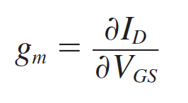
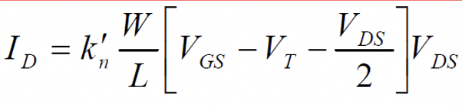
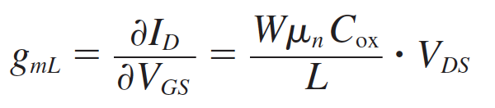

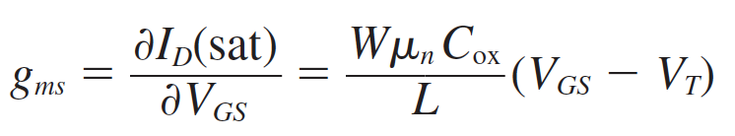
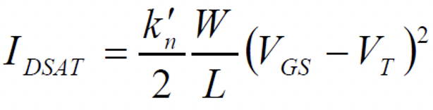

10.4 The basic MOSFET operation
Transconductance:

Slide 67
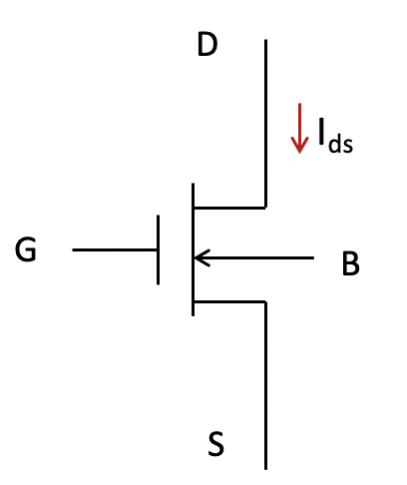
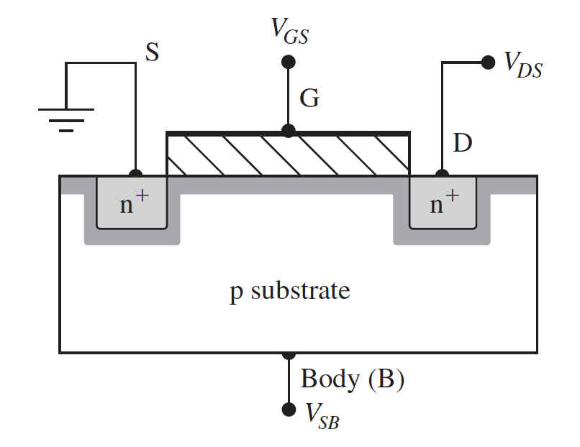

10.4 The basic MOSFET operation
Substrate bias effect
V_{s}
D

Slide 68
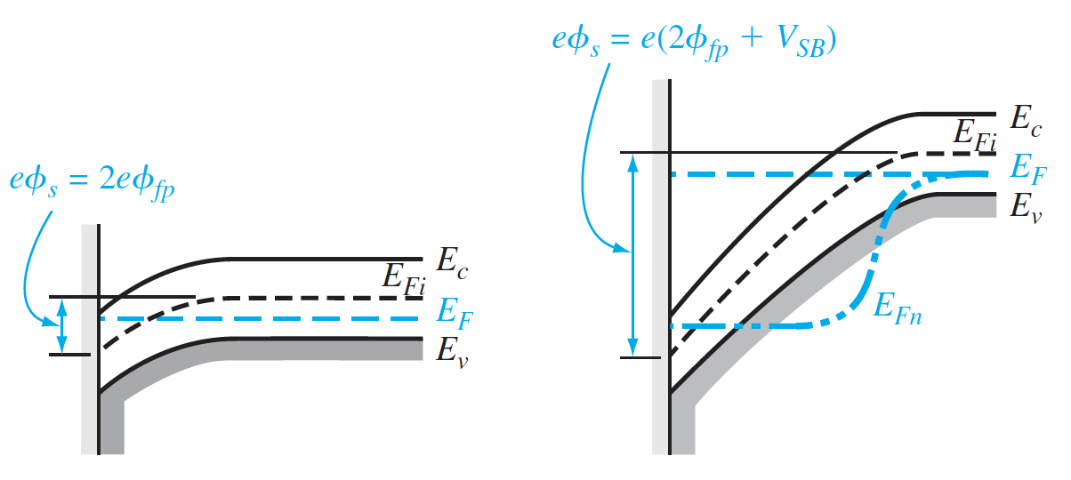
10.4 The basic MOSFET operation
Substrate bias effect
E_{F} of source
V_{s} > 0
E_{F} of source
D
E_{F} of source

Slide 69
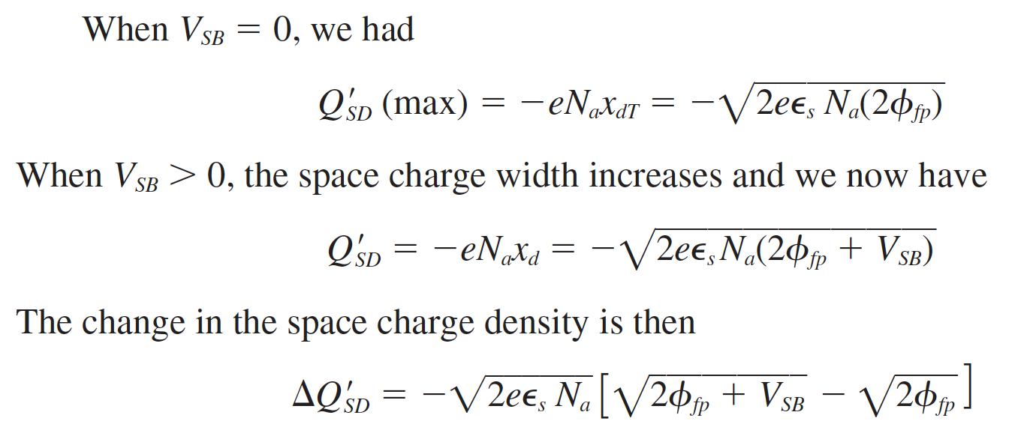
10.4 The basic MOSFET operation
Substrate bias effect

Slide 70
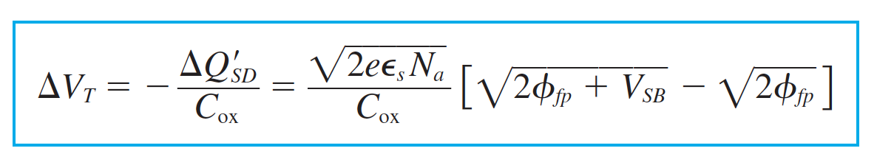


10.4 The basic MOSFET operation
Substrate bias effect

